Slide 1




Context-Based
Automated Program Repair Techniques
Ming Wen
Bo Wang
Supervisor:
Prof. Shing-Chi Cheung
Supervisor:
Prof. Yingfei Xiong
2018-11-24

Slide 2
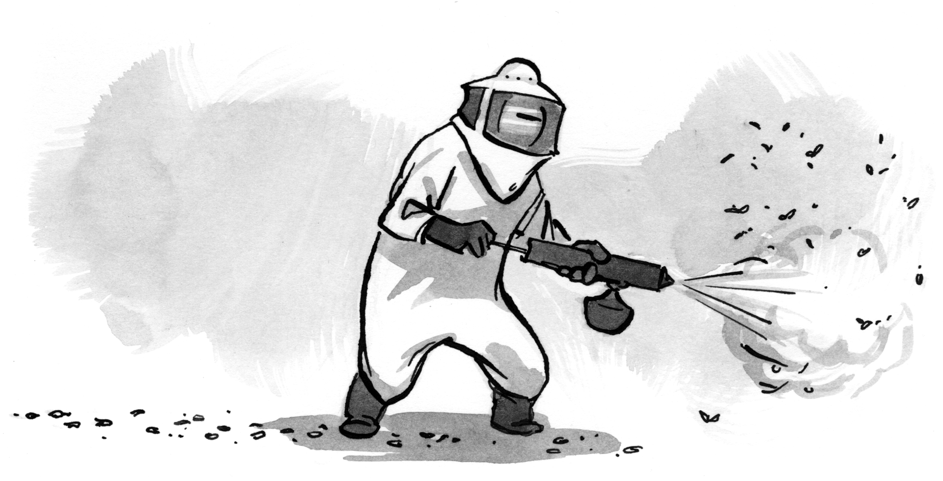

Automated Software Engineering
The estimated cost of debugging is US$312 billion per year¹.
Developers spend 50% of their time debugging¹.
Automated Bug Prediction
Automated Bug Detection
Automated Bug Localization
Automated Bug
Repair?
1. Britton, Tom, et al. "Reversible debugging software." Judge Bus. School, Univ. Cambridge, Cambridge, UK, Tech. Rep (2013).
Notes:
Software is always shipped with bugs, and it requires a large amount of manual effort for debugging.
A study reported that the estimated cost of debugging is 312 billion US dollars per year, and developers spend 50% of the time in debugging.
Therefore, we have put lots of efforts in researches about how to automate these debugging process.
We have developed tools to predict defects automatically, detect bugs automatically and also to automatically locate bugs.
Our ultimate goal is to erase these bugs. However, whether it is feasible and how to do it remains unknown.
Therefore, lots of efforts have been put into the researches about automated bug repair recently.

Slide 3
Automated Program Repair (APR)
This problem was first formulated in 2005 [CAV 2005].
It is in 2009 that GenProg was proposed, since which APR has gain huge attention in software engineering community [ICSE 2009].
Publications selected from:
ICSE, FSE, ASE, ISSTA,
TSE, PLDI, POPL
Notes:
This problem was first formulated in 2005.
We can see the trend of this topic by means of the number of related papers published on top venue conferences.
During the last five years, the number keeps increasing, and there are 13 APR papers in the last year.

Slide 4





Core Concepts
A program is buggy if the expected behavior is deviated from what is actually observed.
In automated program repair, the expected behavior is usually specified by the provided test suite, deviation is observed if any test case fails.
A program is regarded as buggy if it fails at least one test case.
Automated Program
Repair (APR)
[Input: Buggy Program+ A Test Suite]
[Output: The Fixed Program]
Notes:
Here, we first introduce some core concepts required for understanding automated program repair techniques.
The buggy program plus a test suite which reveals the bug.

Slide 5
Search-based Automated Program Repair
1.Fault
Localization
2. Patch
Generation
3. Patch Prioritization
4. Patch
Validation
The General Steps of Search-Based APR
CapGen
ConCap
Patch Generation
Driven by Mutation Operators
Learned from Open Source Projects
Driven by a Synthesis Model
Learned from Open Source Projects
Patch Prioritization
Ranked by the Likelihood of Operator
Space and Ingredients Space
Ranked by a Learned Machine Learning
Model to Synthesize Possible AST

Slide 6

CapGen: Context-Aware Patch GENeration Approach
Patch Generation
Candidate Patches
Choosing a Location
Correct Patches
Fault Space
Challenge#1
The correct patches are outside of the search space
Choosing a
Mutation
Operator
Fix Space
Challenge#2
Choosing a Fixing Ingredient
Search Space
Ingredients Space
The search space is huge
Timeout
Notes:
There are three steps in order to generate a patch to repair a buggy program.
First, we need to choose a buggy location, we then choose a mutation operator, which makes some modifications to the chosen buggy location.
Finally, we need to choose a fixing ingredient in order to generate the patch.
Actually, these three steps determines the three spaces, which are the fault space, fix space, and the ingredient space.
These three spaces collectively determines the search space of search based automated program repair.
Therefore, there are two challenges for existing program repair techniques.
First is that the correct patches are outside of the search space.
The second is that the search space is huge, therefore, the correct patches can not be successfully identified during a time budget.

Slide 7
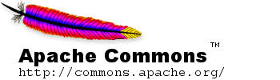



CapGen: Context-Aware Patch GENeration Approach
Motivation
Challenge#1
The correct patches are outside of the search space
Apache Commons Math (63 from Defects4J)
417:
$$return (Double.isNaN(x) \&\& Double.isNaN(y)) || x == y;$$
417:
$$return equals(x,y, 1)$$
Fixing Ingredients
422:
$$return (Double.isNaN(x) \&\& Double.isNaN(y)) ||$$
$$equals(x,y, 1)$$
442:
$$equals(x,y, 1)$$
$$return || FastMath.abs(y − x) <= eps;$$
Notes:
For the first challenge, we made some interesting observations.
Here, we show an example of an real bug.
The return statement at line 417 is buggy, and thus the return expression should be replaced with another method call.
Actually, the fixing ingredient exist in the same program at somewhere else.
2. If we work at the statement level, in which we replace line 417 with either line 422 or 442, we can not successfully repair the bug.
Actually, we need to work at a finer granularity. In which case, we need to extract the partial expressions from line 422 or 442

Slide 8

CapGen: Context-Aware Patch GENeration Approach
Motivation
Challenge#1
The correct patches are outside of the search space
Working on finer granularities such as the expression level
Further increase the search space, thus increasing the Challenge#2
Fault Space
Fix Space
Ingredients Space
How to select a suspicious location?
How to select a good mutation operator?
How to find a good fixing ingredient?
Prioritized by fault localization techniques
Can be prioritized via leveraging contextual information
$$<l, susp>$$

Slide 9
CapGen: Context-Aware Patch GENeration Approach
Observation of Fix Space
Context Information
Example
417:
$$return (Double.isNaN(x) \&\& Double.isNaN(y)) || x == y;$$
Method Invocation
Identifiers
Boolean Values
The syntactic usage of code elements is highly contextual [Qiu et.al., JSS’2017]
Return
Expression
Identifiers
27.2%
Augmented with those context, we can prioritize mutation operators
Method Invocation
24.4%
Boolean Values
6.2%
Notes:
Gi back to our previous example, to fix the buggy return statement, we can choose different types of expressions to replace it.
As pointed out by a recent study, the syntactic usage of code elements is highly contextual.
For example, under the context of return statement, identifiers have 27.2% to be selected as the ingredient.

Slide 10


CapGen: Context-Aware Patch GENeration Approach
Observation of Ingredient Space
417:
$$return (Double.isNaN(x) \&\& Double.isNaN(y)) || x == y;$$
Method Invocation
Method#1, Method#2, Method#3,…..
422:
$$return (Double.isNaN(x) \&\& Double.isNaN(y)) ||$$
$$equals(x,y, 1)$$
442:
$$equals(x,y, 1)$$
$$return || FastMath.abs(y − x) <= eps;$$
Both of the expressions are used under return statement.
Both of the expressions use similar variables (e.g., x, y)
Intuition
A fixing ingredient should be applied to the location with similar contexts compared with the location where it is extracted
Notes:
Next, we show our observations towards the ingredient space.
By further investigating the context information between the buggy location and the location where the correct fixing ingredients reside.
We found that they share substantial similar contexts.
For example, both of the expressions are used under return statement.

Slide 11
CapGen: Context-Aware Patch GENeration Approach
Overview
It works at the Expression level.
Finer Granularity
AST Nodes (e.g., Type, Expression and Statement) are
extracted as fixing ingredients.
It leverages Gzoltar to generate the fault space.
Fixing ingredients are extracted from the buggy source file.
It prioritizes the mutation operators.
Context Information
It prioritizes the fixing ingredients.
Notes:
Based on our observations, we design CapGen, an context aware patch generation approach.

Slide 12
CapGen: Context-Aware Patch GENeration Approach
Context-Aware Operators Prioritization
Target Node
Augmented mutation operators with AST Node Types
Source Node
Replace [Target Node Type] with [Source Node Type]
Insert [Source Node Type] under [Target Node Type]
Delete [Source Node Type] under [Target Node Type]
Insertion
Challenge
There are substantial distinct node types defined in JDT.
How to select effective mutation operators.
How to keep a tractable fix space.
Notes:
To prioritize mutation operators. We first identify the source node and the target node.
We then augment the mutation operators with specific AST node types.
For example, we insert a specific source node type under another specific target node type.
However, there are 86 distinct node types defined in JDT.

Slide 13

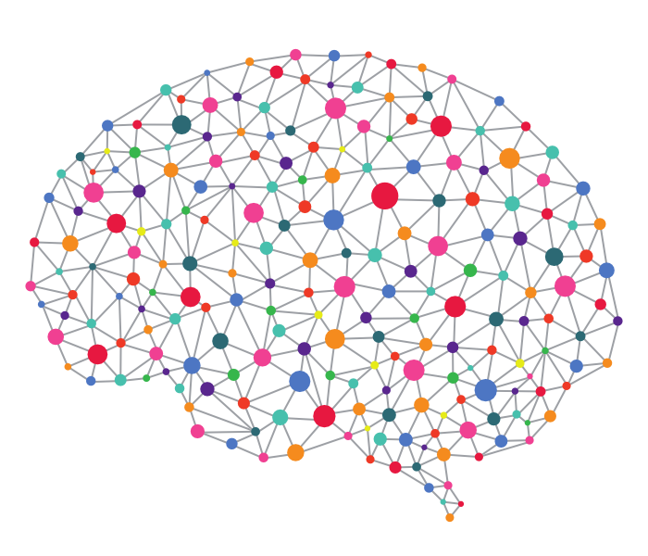


CapGen: Context-Aware Patch GENeration Approach
Context-Aware Operators Prioritization
We Select the
Top 30 Mutation Operators
Over 700
Open-Source Projects
Over 3,000
Real Bug Fixes
Learn the Real Repair Actions (Mutation Operators)
Mutation Operator | Number | Probability
insert EXPRESSION_STATEMENT under METHOD_DECLARATION | 260 | 0.081504702
insert SIMPLE_NAME under METHOD_INVOCATION | 100 | 0.031347962
insert EXPRESSION_STATEMENT under IF_STATEMENT | 97 | 0.030407524
In total 56.58% of the mutation operations have been covered.
Notes:
To address this challenges, we leverage over 700 open source projects, and over 3000 real bug fixes extracted their version histories.
We then learn the real repair actions, mutation operators, from those real bug fixes, and finally select the top 30 mutation operators.
Here, we show some top ranked examples of the insertion operators.
In total, these mutation operators cover 56.6% of the mutation operators that have been observed in practice.

Slide 14
CapGen: Context-Aware Patch GENeration Approach
Context-Aware Ingredients Prioritization
Intuition
A fixing ingredient should be applied to the location with similar contexts compared with the location where it is extracted
Variable Context
Genealogy Context
Dependency Context
Variable Usage Similarity
AST Structure Similarity
Code Semantic Similarity
Our intuition is confirmed by an empirical study
Over 3,000 Real Bug Fixes
Notes:
To prioritize the fixing ingredients, recall that our intuition is that a fixing ingredient should be applied to the location with similar contexts compared with the location where it is extracted.
Based on such intuition, we design three context-aware models, which are the variable context, genealogy context and dependency context.
Our intuition is confirmed by an empirical study, which show that indeed they should share high context similarity.

Slide 15
CapGen: Context-Aware Patch GENeration Approach
CapGen
Context-Aware Patch GENeration Approach
Choosing a Target Node T
Choosing a Mutation Operator M
Choosing a Source Node S
$$Correctness Score\left(<T,M,S>\right)=FL\left(T\right)∗Freq\left(M\right)∗Context(S,T)$$
$$Context\left(S,T\right)=Variable∗Geneology∗Dependency$$

Slide 16
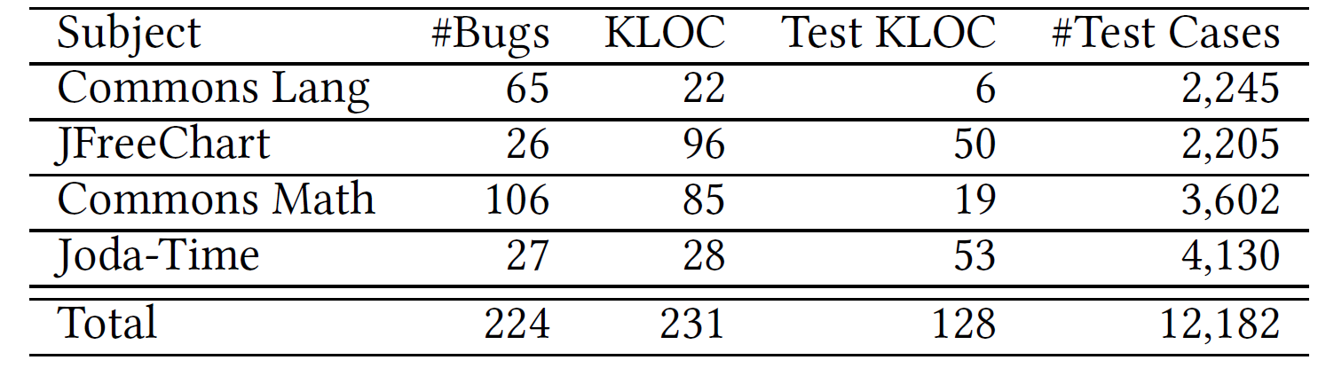
CapGen: Experimental Setup
Subjects
A benchmark Defects4J, which contains 224 real software bugs
The time budget is set to 90 minutes
CapGen keeps validating candidate patches prioritized by their scores until it finds a patch passing all tests or timeout.
Implausible Patches: those do not pass the test suite
Incorrect Plausible Patch: those pass the test suite but are incorrect (overfitting)
Correct Patches: those are semantically the same with the developers’ patches

Slide 17
CapGen: Evaluation Results
[RQ1] How effectively does CapGen fix real world bugs?
CapGen generates plausible patches for 25 bugs.
CapGen generates correct patches for 22 bugs.
CapGen ranks the correct patch in prior to all other incorrect plausible patches for 21 bugs, thus achieving a precision of 84.00% (21/25).
90.48% of them require a fixing ingredient finer than the statement level
98.79% (164/166) of the incorrect plausible patches are ranked after the correct ones.

Slide 18






CapGen: Evaluation Results
[RQ2] Can CapGen outperform existing approaches?
Five state-of-the-art approaches: HistoricalFix, ACS, JGenProg, Par and Nopol.
CapGen
HistoricalFix
$$15$$
$$6$$
$$4$$
CapGen
ACS
$$19$$
$$2$$
$$16$$
CapGen outperforms existing approaches (number of correctly repaired bugs & precision).
CapGen complements well to existing approaches.

Slide 19
Search-based Automated Program Repair
1.Fault
Localization
2. Patch
Generation
3.Patch Prioritization
4.Validation
The General Steps of Search-Based APR
ConCap
Driven by a Synthesis Model
Learned from Open Source Projects
Focus on Repairing If-Statement Related Bugs
Patch Generation
64% of the bugs are related to If-Statement
Patch Prioritization
Ranked by a Learned Machine Learning
Model to Synthesize Possible AST

Slide 20
ConCap: Repair Conditions via Learning to Synthesize
Motivation
Challenge
How to synthesize correct conditions from a huge search space
For current approaches work on finer granularities ➔ A huge search space
Solution
Existing approaches use machine learning methods to rank the patches via their correctness probabilities
Rank all the integrated patches : Elixir
Simple grammar, Simple learning
Existing approaches
Is there any solution can improve?
Rank the abstract patches: Prophet
Ingredients is unable to distinct

Slide 21
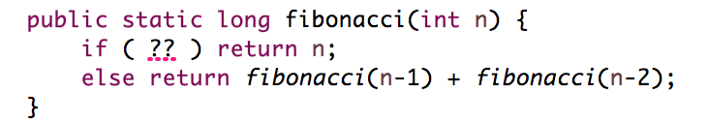
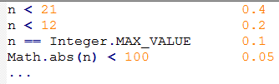
ConCap: Repair Conditions via Learning to Synthesize
Learning to Synthesize
Challenge
Given a code context, estimate the probabilities of the patches within a space
Formally speaking
How to estimate the conditional probability $P(Prog | Context)$?
Learning to Synthesize
Rewriting rules
Constraints
Machine learning
Search
Notes:
Rewriting rule: 定义搜索空间。ML：提供概率。约束：尽早过滤非法展开项，避免不必要计算。搜索：把问题规模限制一定范围内

Slide 22
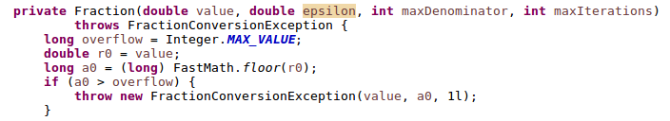
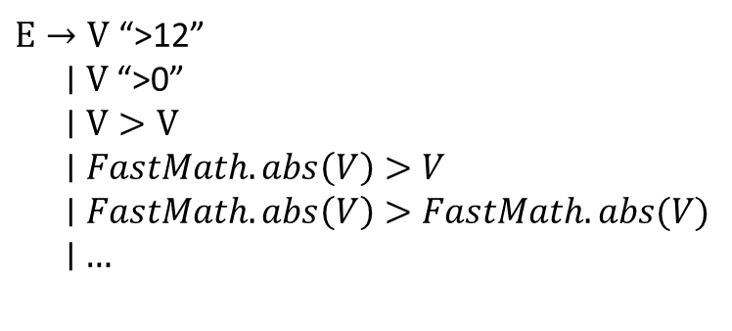
ConCap: Repair Conditions via Learning to Synthesize
Learning to Synthesize: rewriting rule
Rewriting rules
Syntax grammar
Search order
Math-26 from Defects4J
Uniquely fixed by ConCap
$E→V$ “>12” $∣V$“>0” $∣V>V$ $∣FastMath.abs\left(V\right)>V$ $∣FastMath.abs\left(V\right)>FastMath.abs(V)$ $∣$ $…$
Syntax grammar
181:
if (a0 > overflow) {
181:
if ( FastMath.abs(a0) > overflow)
Space: Abstract all the variables of all the existing conditions

Slide 23

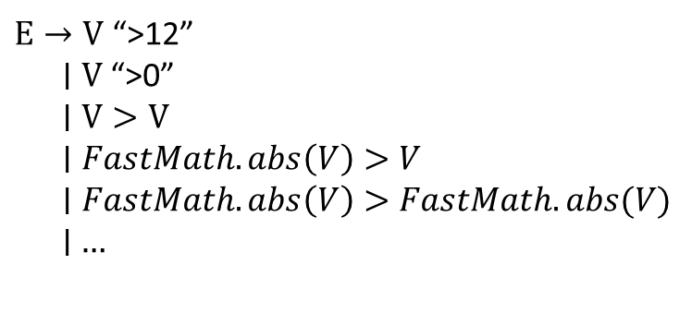





ConCap: Repair Conditions via Learning to Synthesize
Learning to Synthesize: rewriting rule
181:
if ( FastMath.abs(a0) > overflow)
Syntax grammar
Search order
Top-down:
Unfold an unterminal token
Bottom-up:
Expand a terminal token, then complete the expr
$E→V$ “>12” $∣V$“>0” $∣V>V$ $∣FastMath.abs\left(V\right)>V$ $∣FastMath.abs\left(V\right)>FastMath.abs(V)$ $∣$ $…$
E
a0
$$FastMath.abs\left(V\right)>V$$
$$V$$
$$FastMath.abs\left(a0\right)>V$$
$$FastMath.abs\left(V:a0\right)>V$$
$$FastMath.abs\left(a0\right)>overflow$$
$$FastMath.abs\left(V:a0\right)>V:overflow$$
E

Slide 24



ConCap: Repair Conditions via Learning to Synthesize
Learning to Synthesize: machine learning
181:
if ( FastMath.abs(a0) > overflow)
Syntax grammar
Search order
$E→V$ “>12” $∣V$“>0” $∣V>V$ $∣FastMath.abs\left(V\right)>V$ $∣FastMath.abs\left(V\right)>FastMath.abs(V)$ $∣$ $…$
Top-down
E
$$FastMath.abs\left(V\right)>V$$
0.4
$$V>0$$
0.2
$$V>V$$
0.1
…….
a0
0.5
r0
0.3
overflow
0.1
…
…
…
$$FastMath.abs\left(a0\right)>V$$
FastMath.abs(a0) > overflow: P(E| context) P(a0 | E, context) P(overview | a0, E, context)

Slide 25
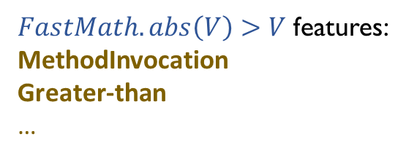



ConCap: Repair Conditions via Learning to Synthesize
Learning to Synthesize: machine learning
E
A probability is learned by a model
$$FastMath.abs\left(V\right)>V$$
0.4
$$V>0$$
0.2
$$V>V$$
0.1
…….
a0
0.5
r0
0.3
overflow
0.1
…
…
…
P(a0 | E, context)
P(E| context)
$FastMath.abs\left(V\right)>V$ features:
MethodInvocation
Greater-than …
Features are extracted from the buggy project
We train a model for each expansion grammar

Slide 26





ConCap: Repair Conditions via Learning to Synthesize
Learning to Synthesize: constrains and search
Constrains
$$V>0$$
Type constrains to filter illegal options
int a0
Object this
double overflow
Search method
E
Beam search, only remain top K expansions
The space is restricted
$$FastMath.abs\left(V\right)>V$$
0.4
$$V>0$$
0.2
$$V>V$$
0.1
…….
If we only remain Top 3…
a0
0.5
r0
0.3
overflow
0.1
…
r0
0.7
a0
0.5
…
…
0.4*0.5=0.2
1st
0.4*0.3
=0.12
2nd
0.4*0.1
=0.04
5th
0.2*0.7
=0.14
3rd
0.2*0.5
=0.1
4th

Slide 27
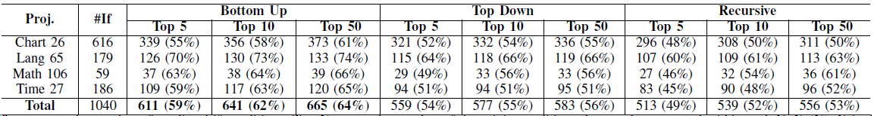
ConCap: Evaluation Results
[RQ1] Which rewriting rule is better?
Subjects: same as CapGen, 4 open-source projects from Defects4J
A comparison of 3 types of rewriting rules, by generating 1040 if conditions.
Bottom-up vs. top-down: same grammar, different order.
Which order is better?
Top-down vs. recursive: same order, the recursive order has a more complex grammar.
Is a more complex grammar better?
The bottom-up rule achieves the best performance
A complex grammar is not always the best
Notes:
Subjects提一下

Slide 28
ConCap: Evaluation Results
[RQ2] How effectively does ConCap fix real world bugs?
143 IF-related bugs
ConCap generates plausible patches for 27 bugs.
ConCap generates correct patches for 22 bugs.
ConCap achieves a precision of 81.00% (22/27).
224 general bugs
ConCap generates plausible patches for 37 bugs.
ConCap generates correct patches for 28 bugs.
ConCap achieves a precision of 76.00% (28/37).

Slide 29
ConCap: Evaluation Results
[RQ3] Can ConCap outperform existing approaches?
All the state-of-the-art approaches: SimFix, ACS, Elixir and others
ConCap fixes more bugs, achieves the highest patch number (number of correctly repaired bugs in both general and IF-related bugs & precision of IF-related bugs).
ConCap complements well to existing approaches. (8 newly fixed bugs)

Slide 30
Thanks! Q & A

Slide 31
Search-based Automated Program Repair
Abstract Syntax Tree (AST)
public class Test {
public String foo(int i) {
if (i == 0) return "Bar";
else return "Foo!";
}
}
CompilationUnit
1
TypeDeclaration
Modifier:Public
2
SimpleName:Test
MethodDeclaration
SingleVariableDeclaration
3
Modifier:Public
4
SimpleType:String
5
SimpleName:foo
SimpleName:String
PrimitiveType:Int
10
Block
6
7
8
9
SimpleName:i
If-Statements
IfStatement
11
12
InfixExpression:==
13
ReturnStatement
14
ReturnStatement
15
NumberLiteral:0
16
SingleLiteral:Bar
17
SingleLiteral:Foo!
SimpleName:i
18
19
20
21
Notes:
Before introducing automated program repair, we introduce the Abstract Syntax Tree since all the modifications are based on the tree structure of the source code.
Here, we show a small piece of code and the corresponding AST.

Slide 32
Search-based Automated Program Repair
Abstract Syntax Tree (AST)
CompilationUnit
1
TypeDeclaration
Modifier:Public
2
SimpleName:Test
MethodDeclaration
SingleVariableDeclaration
3
Modifier:Public
4
SimpleType:String
5
SimpleName:foo
SimpleName:String
PrimitiveType:Int
10
Block
6
7
8
9
SimpleName:i
IfStatement
11
12
InfixExpression:==
13
ReturnStatement
14
ReturnStatement
15
NumberLiteral:0
16
SingleLiteral:Bar
17
SingleLiteral:Foo!
SimpleName:i
18
19
20
21
APR focus on two categories of nodes: Statement and Expression.
Especially focus on If-Statement and If-Condition Expression.

Slide 33
CapGen: Context-Aware Patch GENeration Approach
CapGen
Context-Aware Patch GENeration Approach
It works at the Expression level.
Finer Granularity
AST Nodes (e.g., Type, Expression and Statement) are
extracted as fixing ingredients.
It leverages Gzoltar to generate the fault space.
Fixing ingredients are extracted from the buggy source file.
It prioritizes the mutation operators.
Context Information
It prioritizes the fixing ingredients.
Notes:
Based on our observations, we design CapGen, an context aware patch generation approach.

